Slide 1
Texas City FFA 2022 - 2023

Slide 2
Animal Science Pathway
Freshman Year | Sophomore Year | Junior Year | Senior Year
Taught by: Ms Griffis
Taught by: Mrs Ashcraft
Principles of Agriculture
Small Animal
Equine Science
Vet. Medical Applications I
Vet Med II
Certifications: Level 1 Certified Veterinary Assistant

Slide 3
Plant Science Pathway
Freshman Year | Sophomore Year | Junior Year | Senior Year
Taught by: Ms Richards and Ms Griffis
Taught by: Ms Griffis
Taught by: Ms Richards
Principles of Agriculture
Floral Design
Horticulture
Adv Plant and Soil Science
Certifications: Basic Knowledge, Level 1 and 2 TSFA Floral Design Certification, Benz Floral Certification

Slide 4
TCFFA Dues
TCFFA Dues will be $15.00/ member
dues are used to pay for:
Chapter Dues
District Dues
Area Dues
State Dues
National Dues
FFA Dues will be due by The October 3rd Meeting.

Slide 5
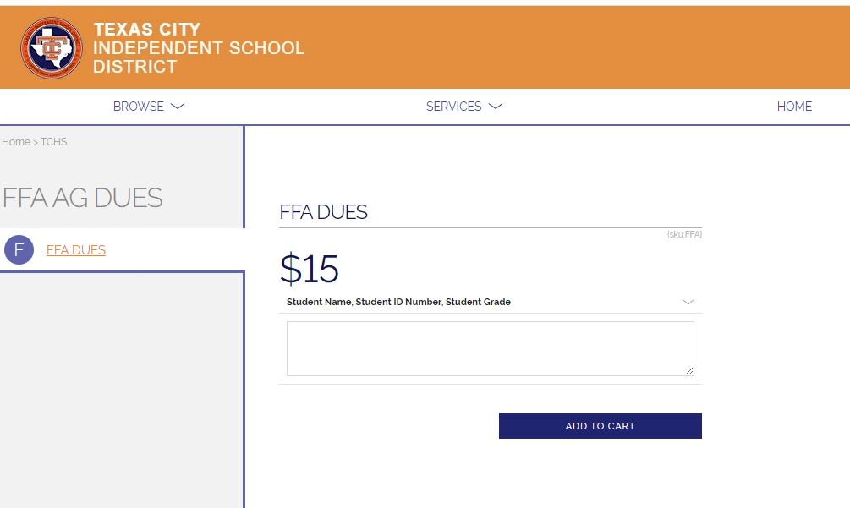
TCFFA Dues online payment option
Dues may be paid online through RevTrak

Slide 6
TCISD Activity FEE
TCISD has extended the activity fee that 7th-12th grade athletes must pay to compete in TCISD. Each competing student must pay a $25 fee before they can compete with sports/organization.
We are asking that all FFA/Jr. FFA students have this fee paid to Mrs. Andrea King in the field house. High school can pay Ms. Thomas
The fee is only paid one time no matter how many Organizations in.

Slide 7
“What can I do in FFA?”
Leadership Development Events
Career Development Events
Supervised Agricultural Experiences
Talent Contest
Agriscience Fair
Speaking Development Events
FFA Rodeo
Chapter, District, Area, and State Office***
Community Service
**Letterman and Senior Cords Opportunities**

Slide 8
Texas City FFA “No Pass, No Substitute” & Attendance Policy
Texas City FFA has implemented the “No Pass, No Substitute” policy starting with the 2014 Galveston County Fair and Rodeo. In the past, students who failed during the six weeks could have an eligible student substitute show their project at the fair. Texas City FFA will no longer have substitutes for students who are ineligible. If a student fails they will not be able to exhibit their animal at the Galveston County Fair. This is the same rule we abide by at all major shows- There are no substitutes allowed to show at any major show. Texas City FFA abides by the UIL “No Pass, No Play” rule. We will continue to strictly abide by that rule in our chapter. We encourage students to keep their grades up and come to school daily. We want all of our members passing their classes at all times during the school year. **Parents: PLEASE check Home Access Center regularly to make sure your kid(s) are keeping up with their grades.**

Slide 9
Additionally, students who have scramble animals and are bound by the Houston Livestock Show and Rodeo or the Galveston County Fair to bring the animal back to show fail are liable for paying all scramble money back to HLSR &/or GCFR due to not being eligible to exhibit the animal.
Absences will be checked regularly for all FFA/JrFFA members. Students must following the following rules for attendance:
-No more than 8 unexcused absences per semester.
3 Tardies count as on unexcused absence.
- All absences must be documented.
- All documentation MUST be turned in to the school within 48 hours of being absent.
- An Assistant Principal must be contacted ASAP for extenuating circumstances and also communicated with an Ag Teacher.
Failure to comply with the attendance policy will be grounds for removal from Texas City FFA and animal project(s) from the TCISD Ag Facility.
**Entries for shows will be turned in after all required forms and fees are submitted to Mrs. Ashcraft.**

Slide 10
LDEs (Leadership Development Events)
Mrs. Ashcraft | Ms Richards
Ag Issues Public Relations Ag Advocacy Greenhand Skills Senior Skills | Ag Issues Senior Spanish Creed Senior Creed Senior Job Interview GH/SR Chapter Conducting GH/SR Radio Broadcasting
Ms Griffis
Ag Issues Greenhand Quiz Greenhand Job Interview | Senior Quiz Greenhand Creed Greenhand Spanish Creed

Slide 11
Texas City FFA Shooting Team
Must complete the ducks unlimited ecological conservation & management certification
Must have/obtain hunter’s education certification.
Must be enrolled in an ag class at least 1 semester.
Must be an FFA member and is expected to attend FFA meetings.
Students are responsible for soliciting sponsors to offset competition expenses.
Students are responsible for practice costs.
Https://www.Facebook.Com/tchsshootingstings/

Slide 12
Overview of Raising Animals
Barn available to house all animals besides Rabbits
Cost of each animal species varies
Supervisor for each species
Limited stalling
Swine & Rabbits | Lambs & Goats | Cattle & Poultry
Ms. Griffis | Ms. Richards | Mrs. Ashcraft

Slide 13
What Type of Animal Can be exhibited???
Market Steer
Breeding Heifer
Commercial Heifer
Pen of 3 Commercial Heifers
Market Swine
Market Lamb
Market Goat
Market Broilers and Turkeys
Single or Pen of 3 Rabbits

Slide 14
Animal Requirements
If stalled in the barn, must have a signed barn contract turned in and stall fee(s) paid
Can be paid through RevTrak
Attend Chapter Meetings
First FFA Meeting October 3rd
Must pass ALL classes to participate
Barn Workdays Mandatory

Slide 15
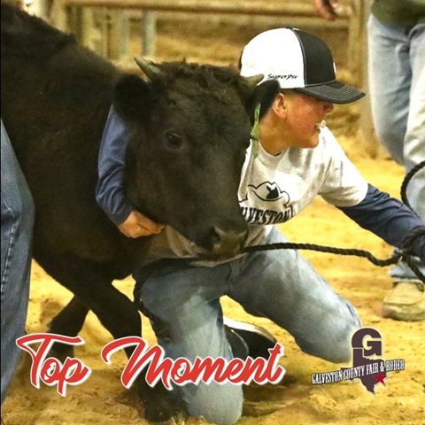
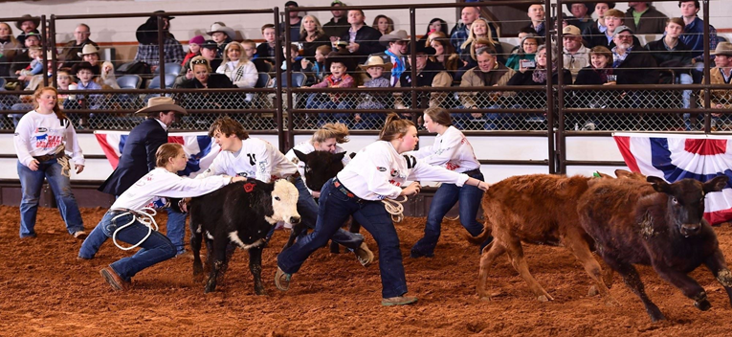
Calf Scramble
Purpose: Chance to earn a certificate towards the cost of a steer or heifer
Contact: Mrs. Ashcraft before Oct. 1st
San Antonio Stock Show & Rodeo (February)
Houston Livestock Show & Rodeo (March)
Galveston County Fair & Rodeo (April)
GCFR has additional meeting students MUST ATTEND

Slide 16
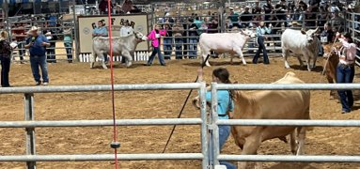
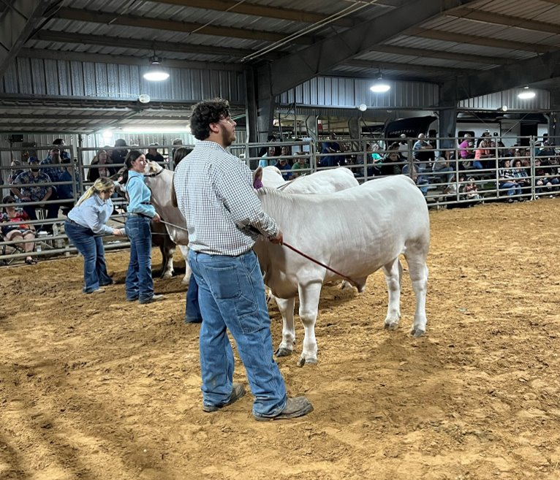
Cattle: Steers & Heifers
Timeframe: 9 month +
Purchase Cost: $2500 and up (varies)
Feed Cost: $200/ month AVERAGE
Contact: Mrs. Ashcraft
Animal is fed 2 times per day. (before and after school)
Animal’s stall is cleaned daily-All stalls must be clean and free of manure when an animal is let out at night.
Entry Fees vary depending upon show.

Slide 17
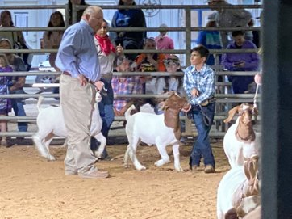
Lambs & Goats
Timeframe: 7-8 months
Purchase Cost: $500+
Feed Cost: $45/ month + (average)
Contact: Ms. Richards
The animal is fed 2 times per day. (before and after school)
Stall is cleaned AT LEAST weekly.
Entry Fees vary depending upon show.

Slide 18
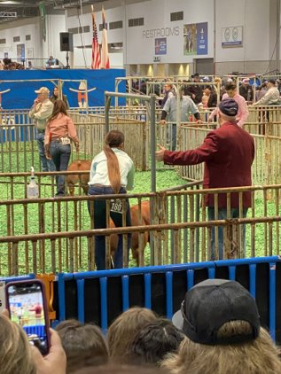
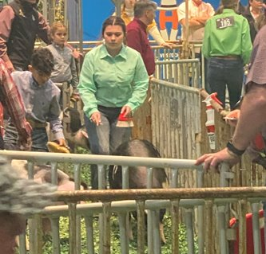
Pigs
Timeframe: 5 - 6 months
Purchase Cost: $350 +
Feed Cost: $200/ month
Contact: Ms. Griffis
Animal stall is cleaned daily.
Entry Fees vary depending upon show

Slide 19
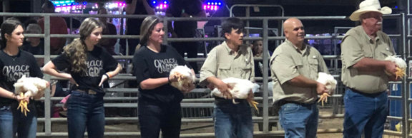
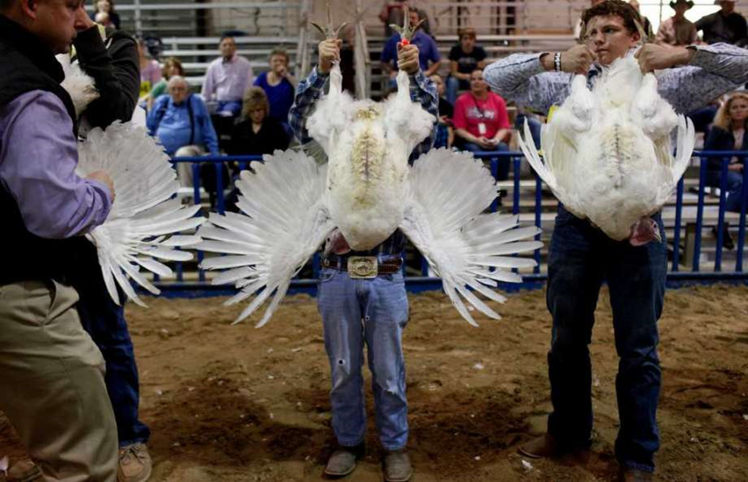
Poultry: Broilers & Turkeys
Timeframe: 6 – 12 weeks
Purchase Cost: purchase prices is usually approximately $1.75 per bird up to 100 birds and a minimum of 25 birds.
Feed Cost: $300/ pen
Contact: Mrs Ashcraft
Multiple feedings per day.
Stall is cleaned daily.
Shavings cost approximately $80.00+ per pen.
Entry Fees vary depending upon show.

Slide 20
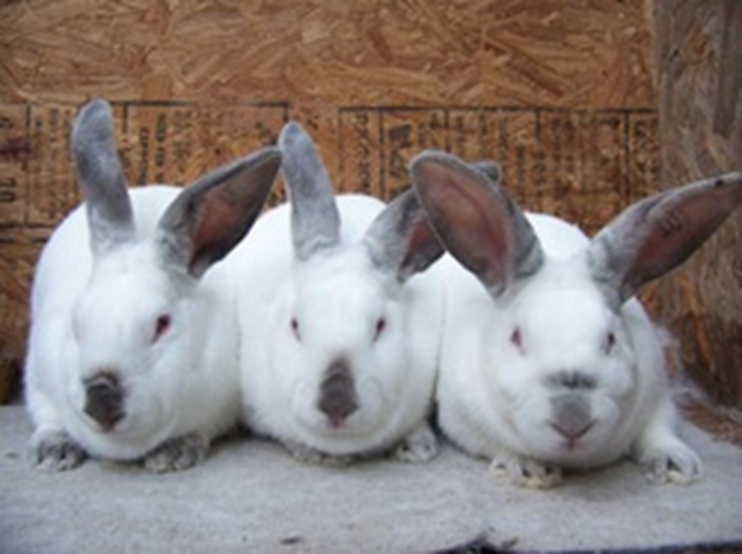
Rabbits
Timeframe: on going project
Student is responsible for finding their own housing. Rabbits are not housed at the TCISD Ag. Facility.
Purchase price of the animal is approximately $60.00+ per breeding rabbit. This project requires you to show the offspring of the breeding rabbits.
Feed Cost: $10/ month average
Contact: Ms. Griffis
Entry fees vary depending on show entered.

Slide 21
Galveston County Fair and Rodeo
Date: Friday april 14-22, 2023
Show and Auction: Week Long
Entry Deadline: Remind will be sent out in advance for each species.

Slide 22
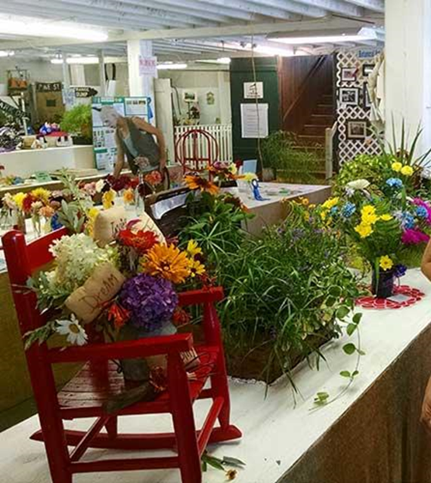
Horticulture
Opportunities for both GCFR and HLSR
Must be a paid FFA Member
Entry Fees and Deadlines vary per show
Contact: Ms. Richards

Slide 23
Ag. Mechanics Project

Slide 24
Ag. Mechanics
Opportunities at Galveston County Fair & Rodeo
Must be a paid FFA Member
Entry Fees vary
Build project from Wood or Metal
Project ideas: Trailers, Agriculture Equipment, Livestock and Wildlife Equipment, Home/Woodwork Projects, Tractor Restoration, Horse Equipment

Slide 25
CDEs (Career Development Events)
Why Compete in CDEs?
Mrs. Ashcraft | Ms. Griffis | Ms. Richards
Vet Med Poultry Livestock | Wool Range Wildlife Milk Quality | Floriculture Entomology Nursery/ Landscape Plant ID

Slide 26
Community Service Activities
Current “Living to Serve” Community service projects will be posted online and in the Reminds

Slide 27
Fundraisers
Fundraisers
Top Salesman Award will account ALL Fundraisers
If selling as a family, will divide total number by amount of FFA members in the family
will be posted in the remind when going on and on social medias

Slide 28
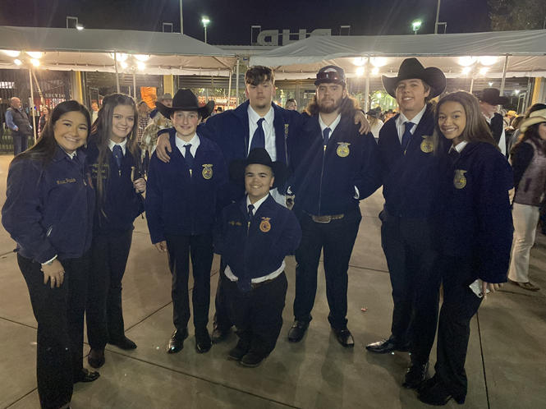
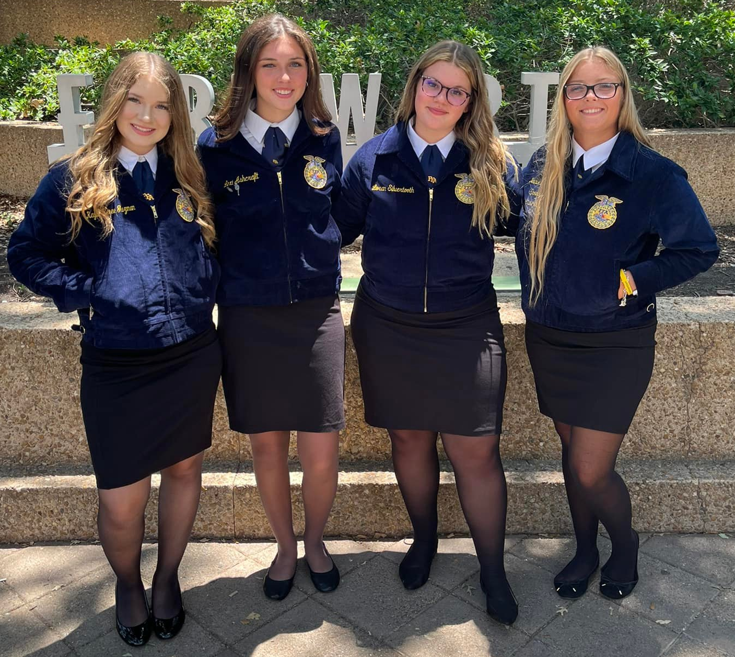
FFA Official Dress
$60 – Jacket & $12 - Tie or Scarf (depends on style)
If you can not afford a jacket but want to participate, contact your teacher about The Gift of Blue
https://shopffa.org/cat/2/OFFICIAL-DRESS/

Slide 29
FFA Banquet
Time: May 2023 (Date TBD)
Place: Nessler Center
Receive recognition for accomplishments
Awards
Senior Speeches, cords, and shooting team stoles
Food

Slide 30
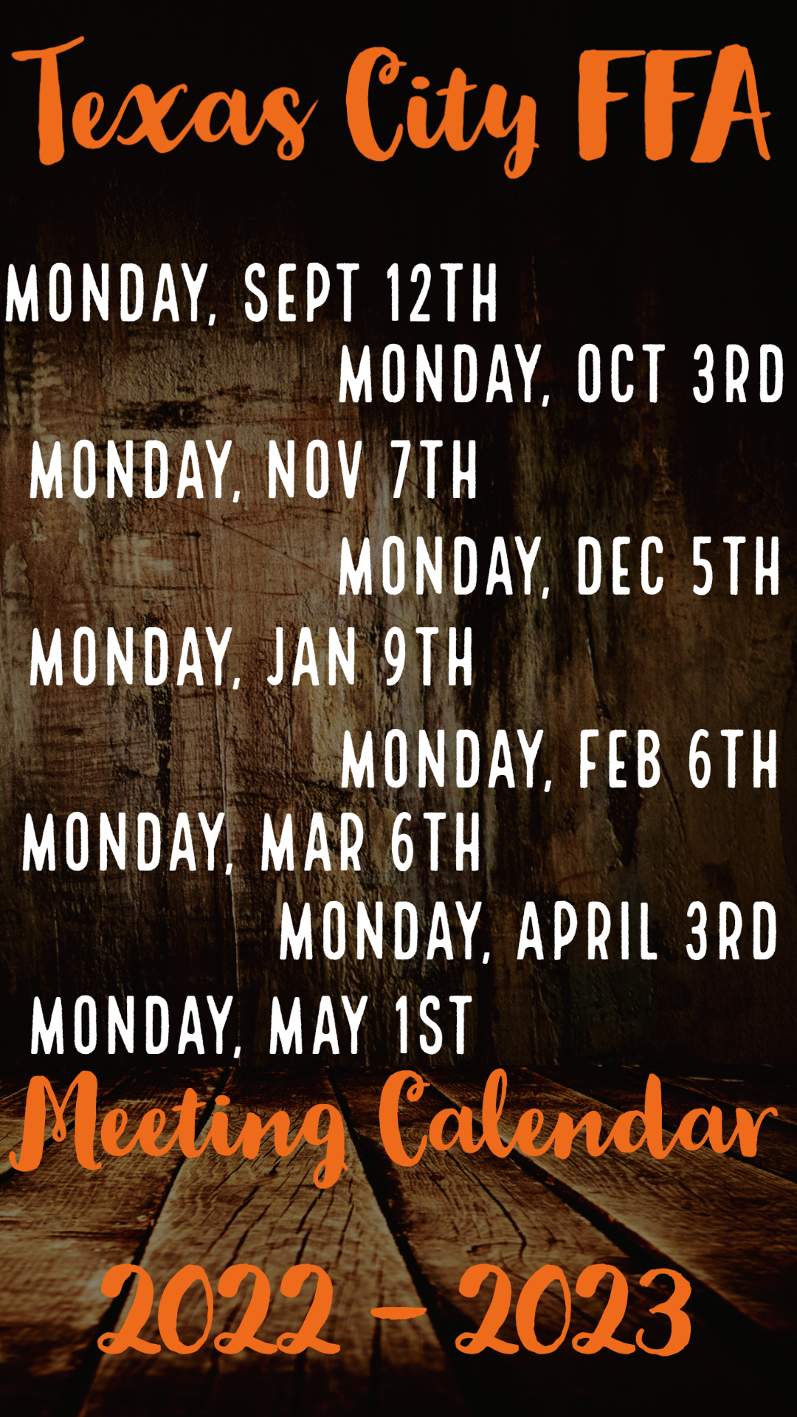
Scan Code to Pay FFA Dues and Barn Stall Fees

